Slide 1
Home Care Aides in the United States
Joanne Spetz, PhD
University of California, San Francisco
September, 2019

Slide 2
Who are home care aides?
(aka personal care aides, or assistants)
Assistance with activities of daily living
  Bathing, dressing, grooming, toileting, transferring, feeding
  Instrumental activities of daily living: cleaning the house, moving within the community, shopping, cooking, taking medications
The US has no national long-term care system
  63% paid directly by the consumer
  28% publicly-funded through Medicaid
    (Program for low-income households; state-managed & shared state-federal funding)
  9% paid by a combination
Nearly 2 million employed in 2016, more than 2.7 million by 2026

Slide 3
How are home care aides employed?
Setting | Worker
Home care organization | Home care aide
Direct employment | Home care aide
Residential care/assisted living | Home care aide
Home health agency | Home health aide
Rehabilitation/ intermediate | Certified nursing assistant Home health aide
Nursing home | Certified nursing assistant

Slide 4





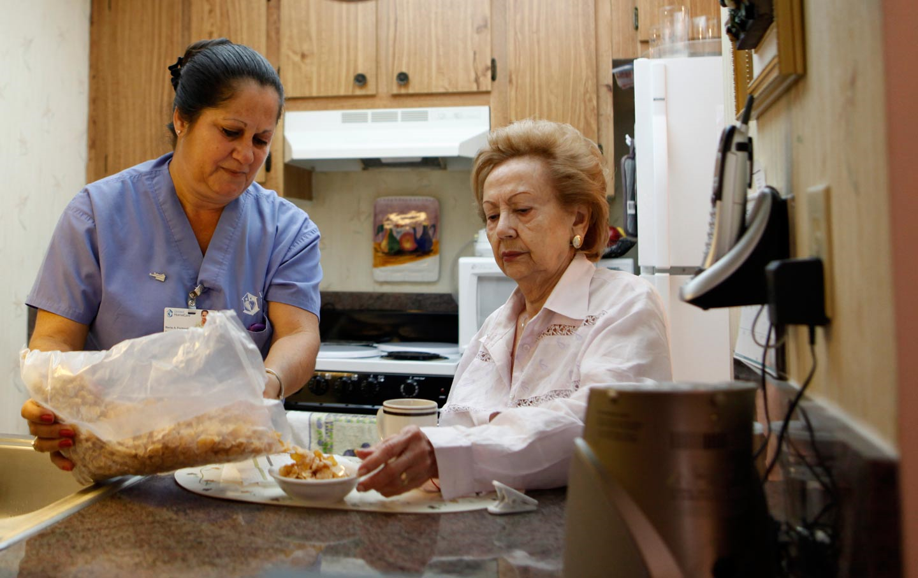
Recruitment issues
Lack of social value for home care work
  Viewed as “glorified maids”
  Media stories of abuse rather than positive value
Inadequate compensation
  Average wage in 2017: $11.12/hour USD
  49% of households receive public assistance
  51% of are <200% of the federal poverty level
Immigration policy

Slide 5

Financing challenges
Most people pay privately
Medicaid has multiple programs
Self-direction options allow beneficiaries to select their aide or how to spend their benefits, including hiring family members in some states
Plethora of unconnected programs lead to inconsistency and confusion

Slide 6
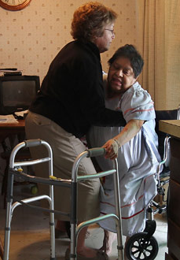
Education and training issues
Inadequate training for complex tasks and responsibilities
No national training standards or requirements
Tremendous variation across state Medicaid programs
  10 had no training requirements in 2014
  19 had uniform requirements across Medicaid programs
Little research on impact of training

Slide 7
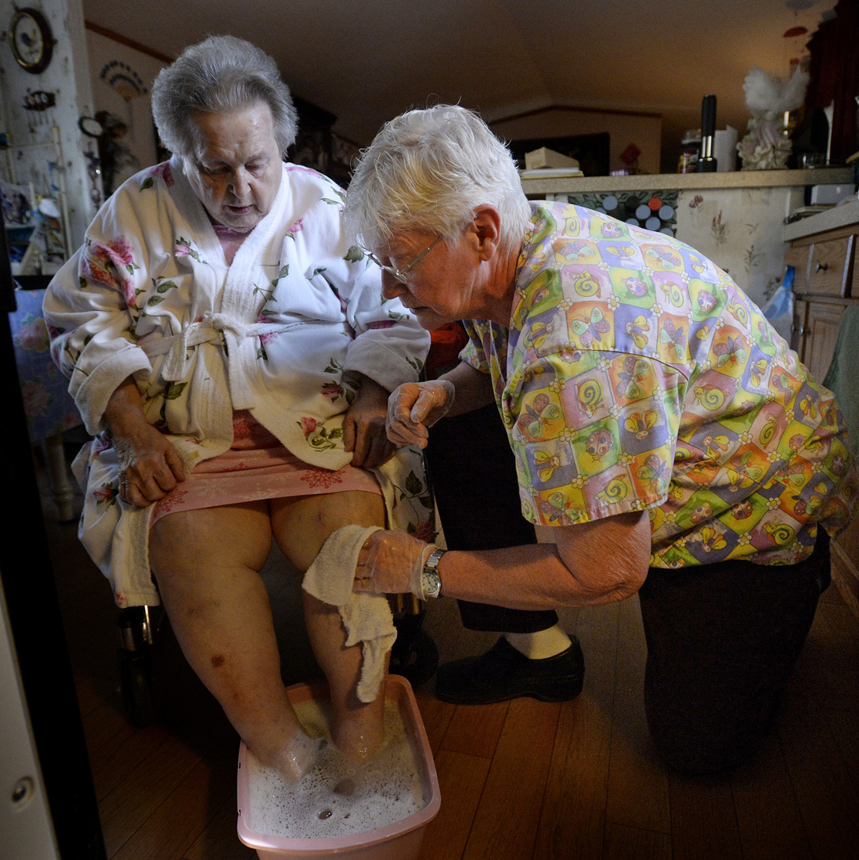
Retention issues
Median industry turnover was 67% in 2017
  Many leave jobs to other industries or to leave the labor force entirely
Turnover is associated with poor client outcomes
Why do workers leave?
  Low-quality supervision
  Lack of autonomy
  Underappreciation
  Occupational safety
  Unstable hours of work
  Lack of career mobility

Slide 8
Regulation challenges
Nurse practice acts control what tasks can be delegated
Tasks such as medication administration, assisting with insulin pumps, changing a wound dressing, clipping toenails cannot be delegated by a nurse in many states
But if you hire an aide privately, there are no regulations

Slide 9
Number of tasks that can be delegated to home care aides

Slide 10

Opportunities for change in the U.S.
Reimbursement through government-funded programs
  “Wage pass-through” requirements, pay-for-performance
Training standards and programs
  Washington state: 75 hours of entry-level training, wage increases for advanced skills
Nurse delegation

